Slide 1

CAPSTONE PROJECT
Secure Data Hiding in Image Using Steganography
Presented By:
Vibhor Gupta
VIT Bhopal (CSE)

Slide 2
OUTLINE
Problem Statement
Technology used
Wow factor
End users
Result
Conclusion
Git-hub Link
Future scope

Slide 3
Problem Statement
With increasing cyber threats, securing sensitive information is crucial. Traditional encryption methods are often vulnerable to attacks. This project focuses on hiding data securely within images using steganography, ensuring confidentiality and preventing unauthorized access.

Slide 4
Technology used
Programming Language: Python
Libraries Used: OpenCV (cv2), OS, String
Platform: Windows/Linux

Slide 5
Wow factors
Data Security: Hides messages inside images, making it undetectable.
Password Protection: Prevents unauthorized decryption.
No Additional Storage Needed: Uses existing image pixels to store data.
Simple and Lightweight: Works with minimal dependencies.

Slide 6
End users
Cybersecurity Experts
Journalists & Whistleblowers
Military & Intelligence Agencies
General Users for Personal Data Security

Slide 7
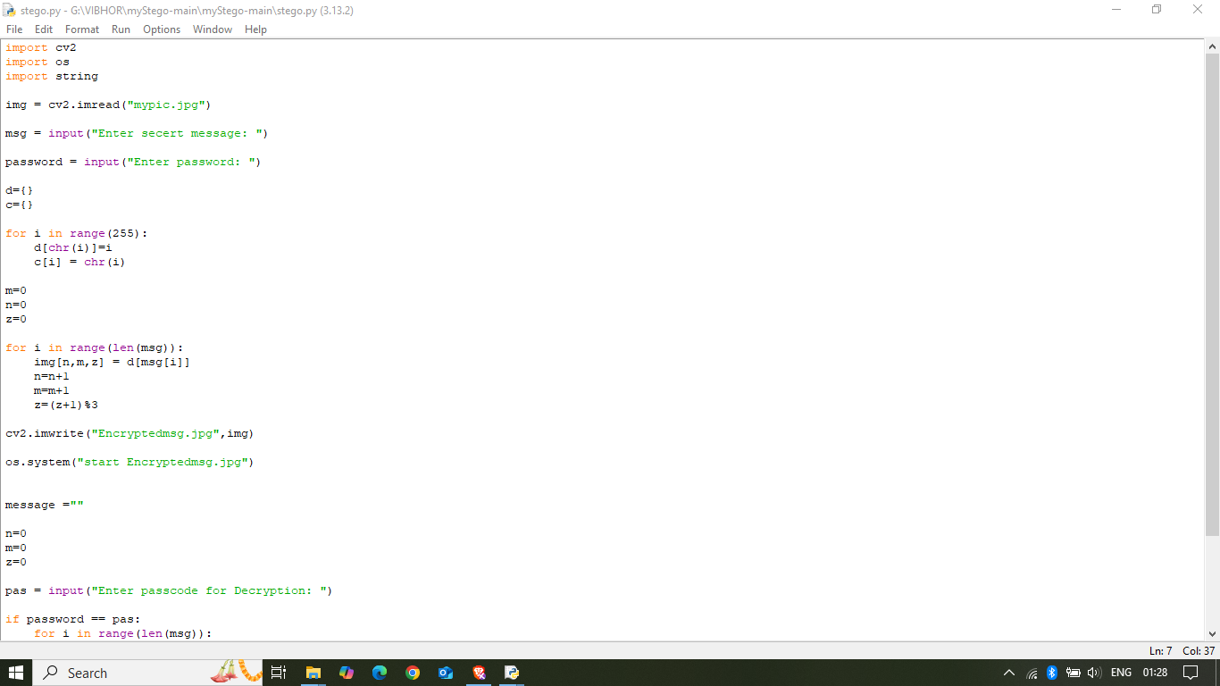
Results

Slide 8
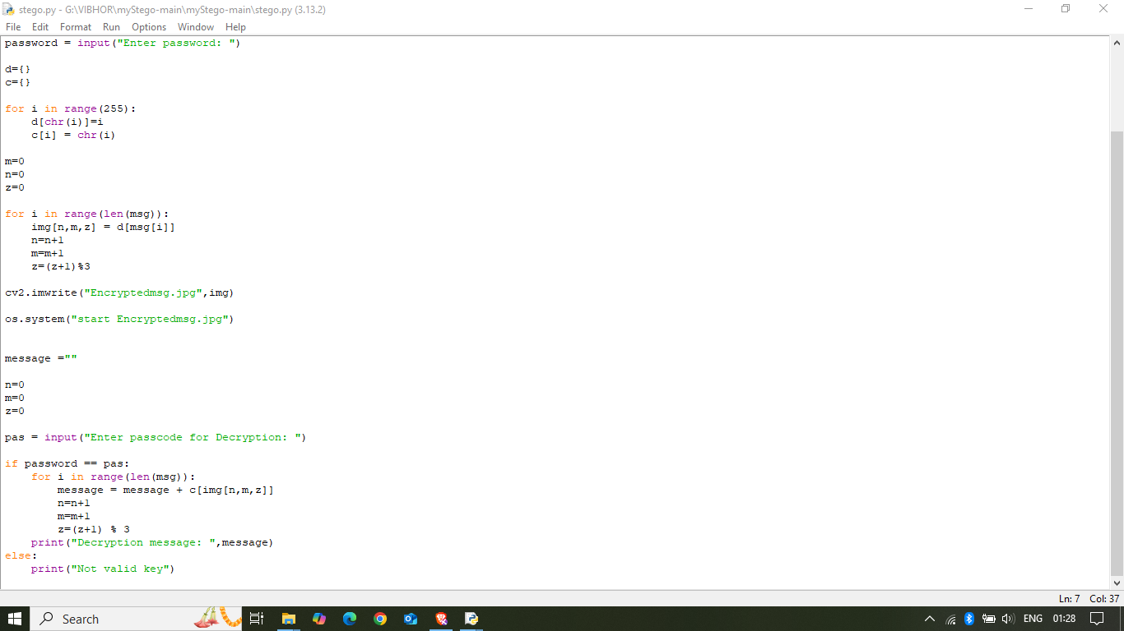

Slide 9
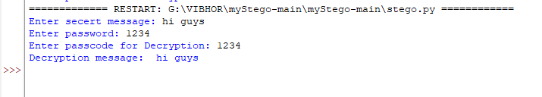


Slide 10
Conclusion
This project successfully implements image-based steganography, providing an additional layer of security for sensitive data. By leveraging image pixels for message storage, it ensures confidentiality while maintaining the visual integrity of the image.

Slide 11
GitHub Link
https://github.com/VIBH0RGUPTA/Stego_project.git

Slide 12
Future scope(optional)
Enhanced Encryption Techniques: Integrating stronger encryption methods before embedding data.
Support for Various Image Formats: Expanding compatibility beyond JPG.
Mobile & Web Implementation: Creating an application for ease of use.
Increased Capacity: Optimizing data embedding to store larger messages.

Slide 13
THANK YOU

